Slide 1
Triggers

Slide 2
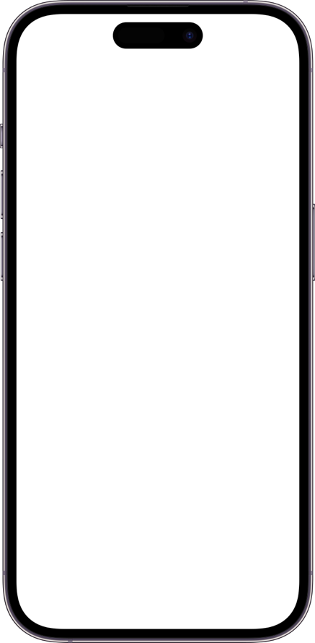
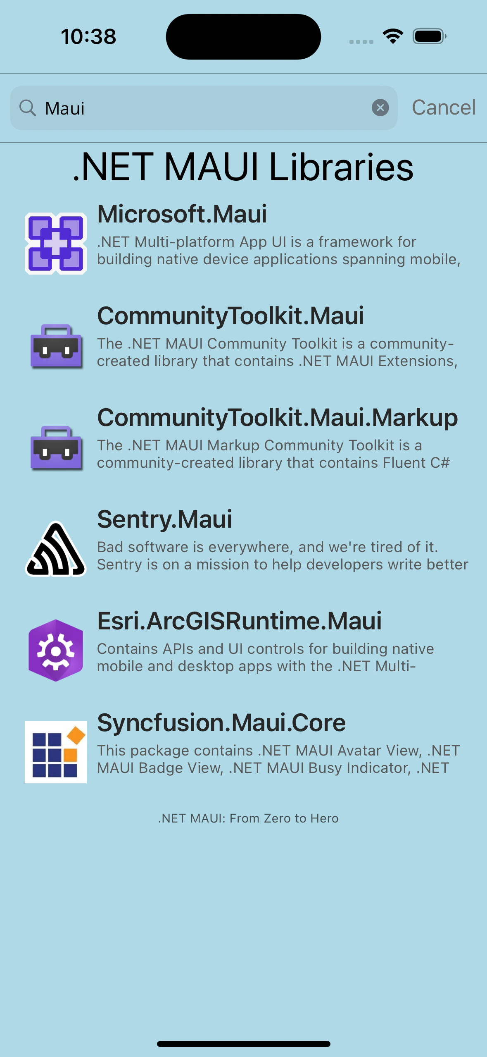
Creating UI Triggers
Searchbar
TextColor grey when disabled
Performs an action when condition is met
Can be added to any VisualElement
Commonly used with Visual States
(Example) Change text color when VisualState is Disabled
Searchbar TextColor Trigger
Sample from .NET MAUI Community Toolkit

Slide 3
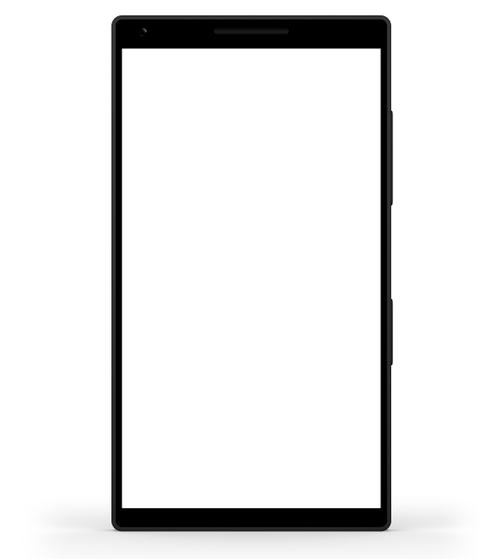
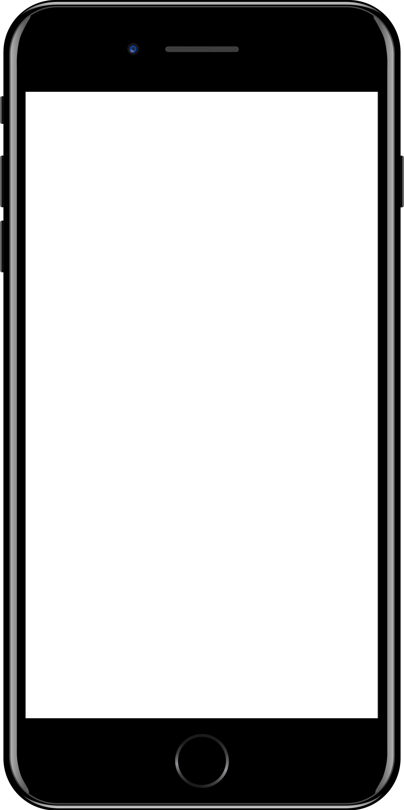
Sample mobile app slide
iPhone 7/8
iPhone 14
Generic phone
(BrandCentral)
App screenshots can be placed behind these transparent .pngs

Slide 4

Sample website slide (blank)
Website screenshots can be placed behind this transparent .png

Slide 5
Bullet points layout with subtitle Subtitle is smaller in the same text block
Example of a bulleted slide with a subhead
Set the slide title to “Sentence case”
Set subheads to “Sentence case”
Hyperlink style
www.microsoft.com

